Slide 1
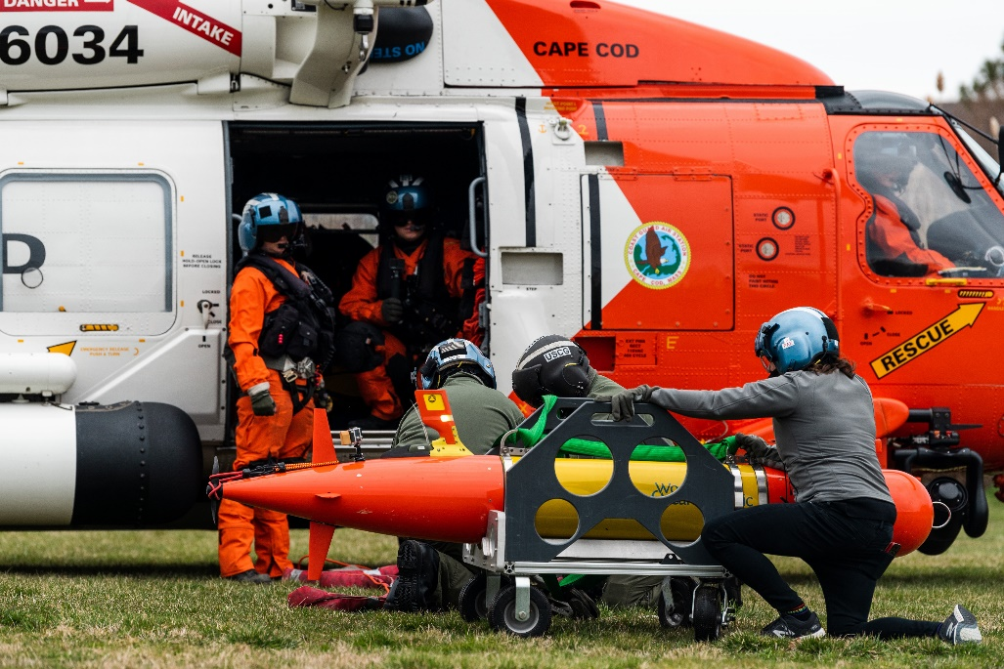
ADAC Year 7 Annual Meeting
...Via Conference Call, 2-3 June 2021
ADAC Project Briefing
(LRAUV) for Under-Ice Mapping of Oil Spills and Environmental Hazards
PI Amy Kukulya (WHO), PI Dr. Jim Bellingham (WHOI),
PI Brett Hobson (MBARI)

Slide 2
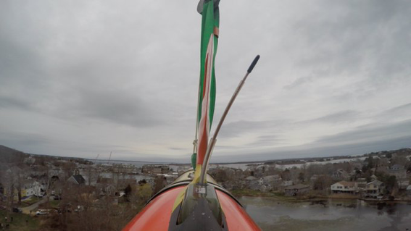
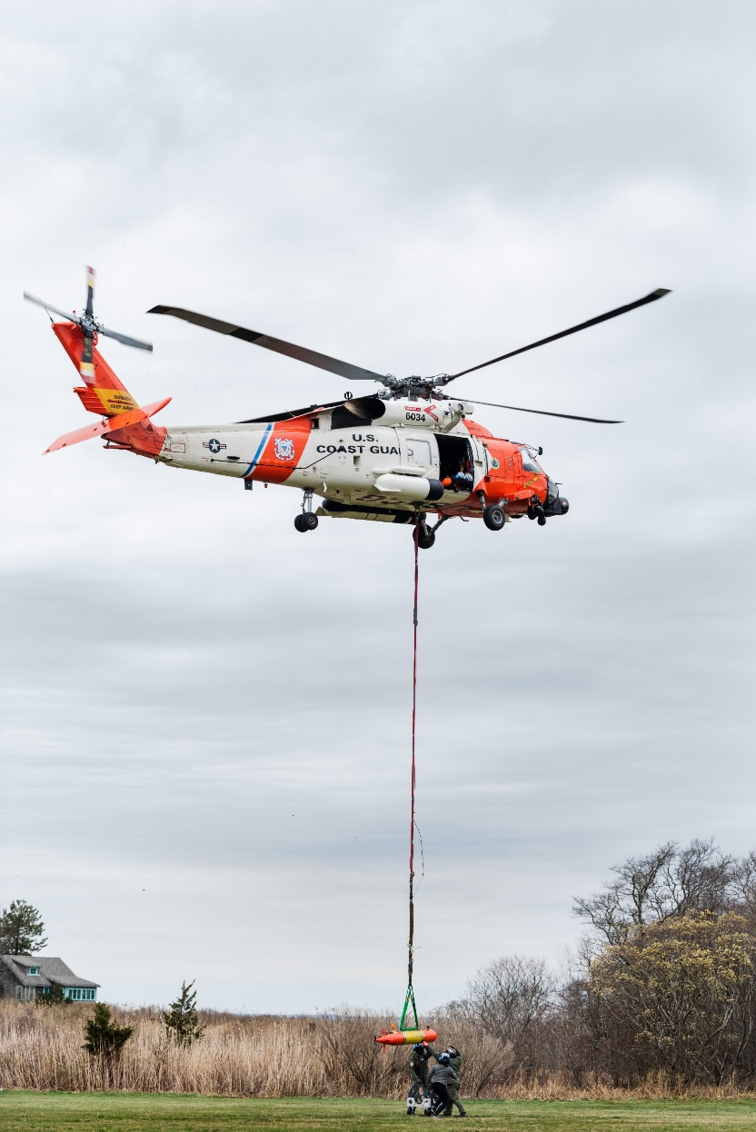
ADAC Project (LRAUV) for Under-Ice Mapping of Oil Spills and Environmental Hazards
ADAC Program Year 7 Annual Meeting 2-3 June 2021
Project Principal Investigator(s): PI Dr. Jim Bellingham (WHOI), PI/PM Amy Kukulya (WHOI), Co-PI Brett Hobson (MBARI)
Woods Hole Oceanographic Institution, Monterey Bay Aquarium Research Institute
Supporting Team: Daniel Gomez-Ibanez, Noa Yoder, Amanda Besaw, Brian Kieft, Ben Raanan, Ryan Govostes, Steven Seeberger
Project Champion: Kirsten Trego, HQ USCG MER
Project Advocates: Dr. Robyn Conmy, EPA USEPA/NRMRL/RTEB, USCG Research and Development Center, Dr. Jay Choy BSEE/Oil Spill Preparedness Division, Dr. Lisa Dipinto, NOAA, Office of Restoration and Response, Mr. Brian Dolph, USCG R&D Center

Slide 3
LRAUV: Description and Baseline
ADAC Program Year 7 Annual Meeting 2-3 June 2021
Baseline: Currently, there is no USCG baseline for an AUV to meet the unique demands of Arctic operations that requires a minimal logistical footprint, a small operational team and oil detection and mapping capability.
Project Description: To develop an Arctic-capable long-range Autonomous Underwater Vehicle (AUV) that is helicopter portable, carries an environmental mapping payload, allowing rapid response while providing situational awareness and damage mitigation for first responders/USCG.

Slide 4
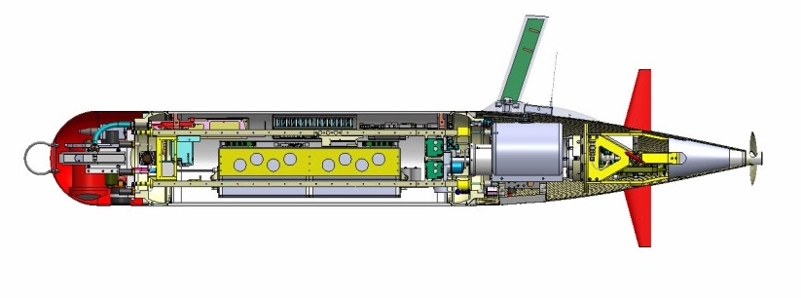
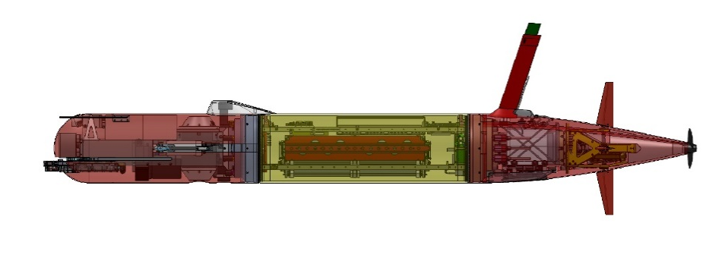
Tethys LRAUV Specifications
Core sensors: DVL/ADCP , Fluorometer/ Backscatter (WetLabs), CTD (Seabird), PAR, O2
Iridium, GPS, WiFi and Cellular in mast
Backup Argos and VHF
Load Control System
18 configurable channels
Isolates load, circuit breaker, ground fault detection
Buoyancy Engine allows neutral drift in water column - 1 Liter
Efficient low-speed propeller
------------------
Paired Rudder and Elevator Control Surfaces
Docking Module
6 kWh rechargeable,
11 kWh expendable
Shifting Mass allows controlled angle of attack during flight
INS Module
Short Nose
With Mapping Module
Mass: 110 kg ( 240lb) dry weight 118 kg (260 lbs)
Size: 0.3m (12”) diameter, 2.47m long 2.75 m long
Speed: 0.5 – 1.2 m/s plus hover 0.5 – 1.0 m/s plus hover
400 Ah energy, ~1.1 Ah/hr, 400 Ah energy, ~1.5 Ah/h ~3 km/hr .83 m/sec ~15 days, 1000 km See different modes below
Mode: 5 day RT transit out 120 km = 1800 W-hrs; 28 hours of survey= 2800 W-hrs;
13.5 days of slow science = 4600 W-hrs
300 A-hr useable at 15.3v=4600 W-hrs
Notes:
Need new power numbers

Slide 5
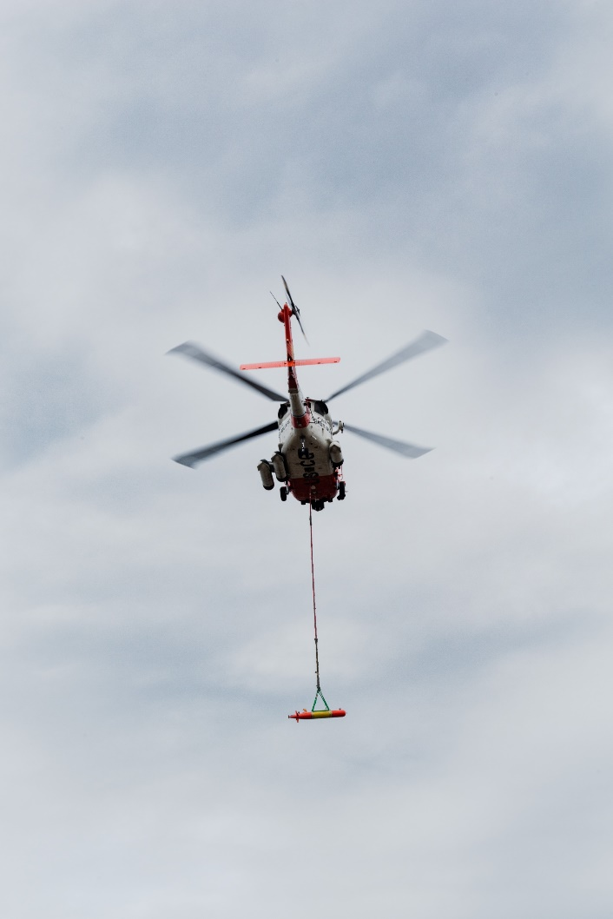
Project LRAUV Relevance and Method
ADAC Program Year 7 Annual Meeting 2-3 June 2021
Relevance to DHS and USCG: We characterize the challenge as the ‘last seat in the helicopter’ problem: If first responders are operating at the far end of their logistical support capability, the system must be able to fill that void.
Research Method: Our approach is to leverage an existing Long-Range AUV developed at MBARI (LRAUV), and enhance the system to detect oil and operate under ice. LRAUV offers extended ranges (one to three weeks), and can be operated by a team remotely and monitored by anyone, anywhere.
  Next up:
    Prior (where you have been)
    Current (where you are at)
    Projected (where you are going)

Slide 6
ADAC New Kit & Updates For Program YR7
ADAC Program Year 7 Annual Meeting 2-3 June 2021
Soundtrap self-contained soundscape sensor integrated in the long noses
Inertial navigation (integration inside housing) mounting design completed
Multibeam for mapping – working on data conversion for MB Systems- in process
Multi-channel low frequency diversity array (have hardware, for 400 km range receive only navigation pings, works with receiver) all hooks in place to integrate
Low-frequency receiver for long distance navigation (hundreds of kilometers) in hand
Chelsea UviLux- has a lower excitation (SeaOWL) wavelength, it gives you a clearer dissolved oil signal that can be discerned from natural humic DOM. (have sensor, integration lower priority, but compliments SeaOWL) mechanical mounting complete
Upgrade to CTD/DO: completed!
Backseat computer for more versatile control of sensor integration/new behaviors. Integrated on Polaris and testing underway! ROS development underway and continues into YR8

Slide 7
ADAC Program Year 7 Annual Meeting 2-3 June 2021
Key Accomplishments
Where we have been:
  MC20 surveys with R-100 and a Seaowl (2016)
  Two dye demonstrations (Woods Hole (R-100) and Monterey (Polaris)
  Built Polaris!
  Ran two Santa Barbara Seeps experiments with Polaris
  Developed three communications and docking buoys
  Developed dynamic docking and homing capability for LRAUV
  Ran first ever under-ice surveys in Bog Lake (2021)
  Picked and launched Polaris from a USCG Jayhawk helicopter
  WHOI is fabricating a second platform, Stella with multi-mission capability and can operate and develop and manufacture LRAUV in house at WHOI!
  Added a new bulkhead (9th) connector for another sensor
  Added backseat CPU for easier software and sensor development
  Redesigned the antenna! Tall for open ocean and stubby for under-ice. Fully tested!
  Proved we can run from shore to the shelf and back home (with a ship). We completed a 265 km mission with 8 days of battery left in the tank!!!
  Patent!

Slide 8
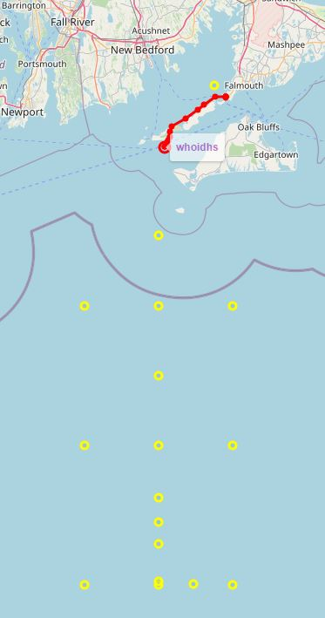
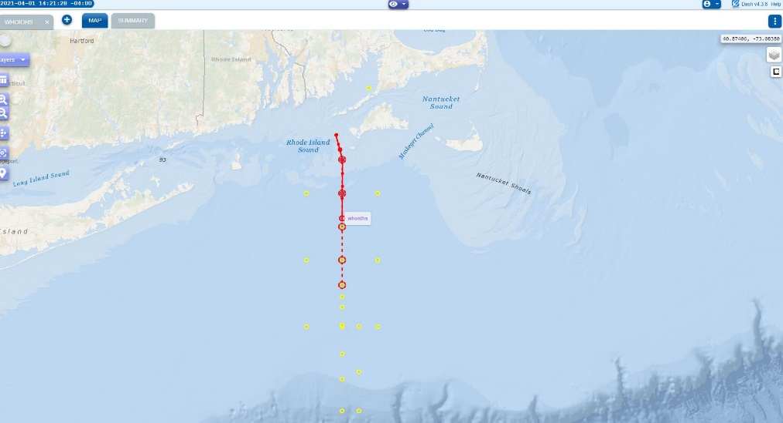
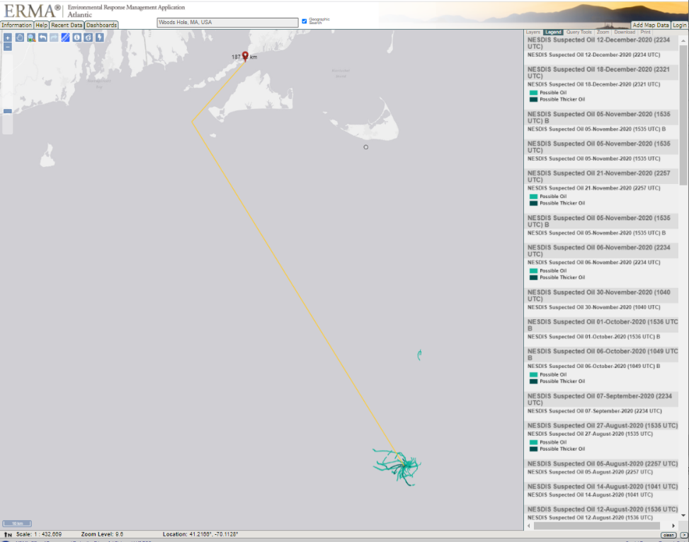
ADAC Program Year 7 Annual Meeting 2-3 June 2021
Overview of over-the-horizon mission – Shipless Operations
188 km from Woods Hole shipwreck actively leaking oil….in LRAUV wheelhouse (Scott Lungren (NOAA)

Slide 9
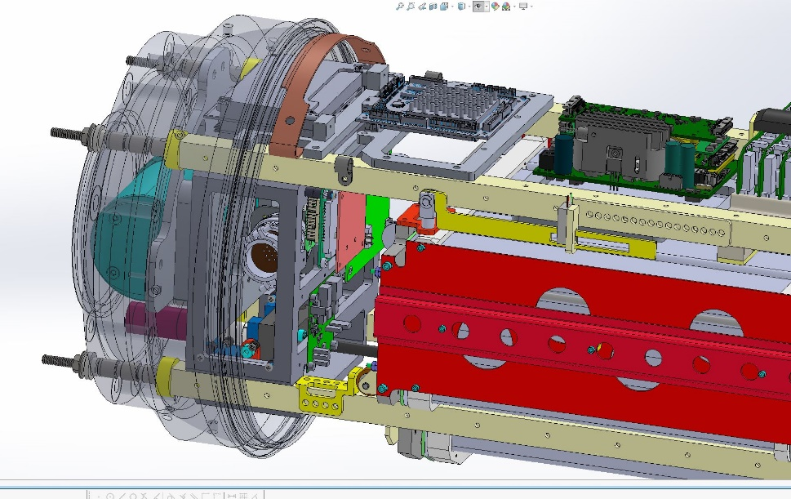
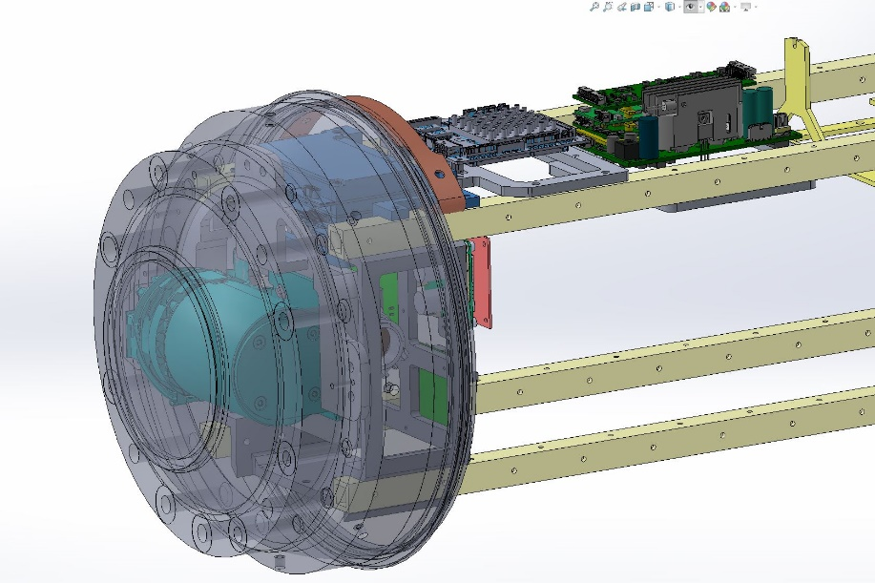
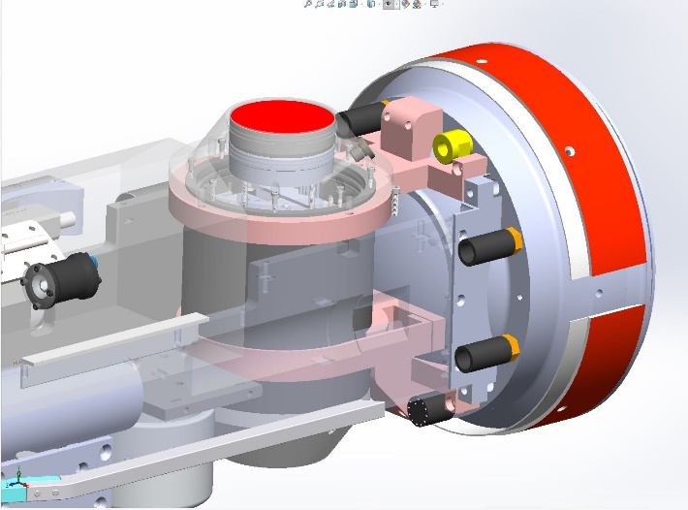
ADAC Program Year 7 Annual Meeting 2-3 June 2021
Where we are at:
  Developing LBL (currently being testing)
  Integrating multibeam
  Building Stella and systems
  Refining docking (extreme cold tolerant gearbox)
  Developing onboard sim mission for plume tracking tests
  Updating plume tracking algorithm
  Building second docking nose (for Stella)
  Designing bracketry for new ADCP and IMU configuration ( in shop)
  Working on software for GPS, time, timing (1 PPS), for IMU and sonar, new PIC board
  All updated wiring for new sensors and config
  Building vehicle in a box (for rapid testing)

Slide 10
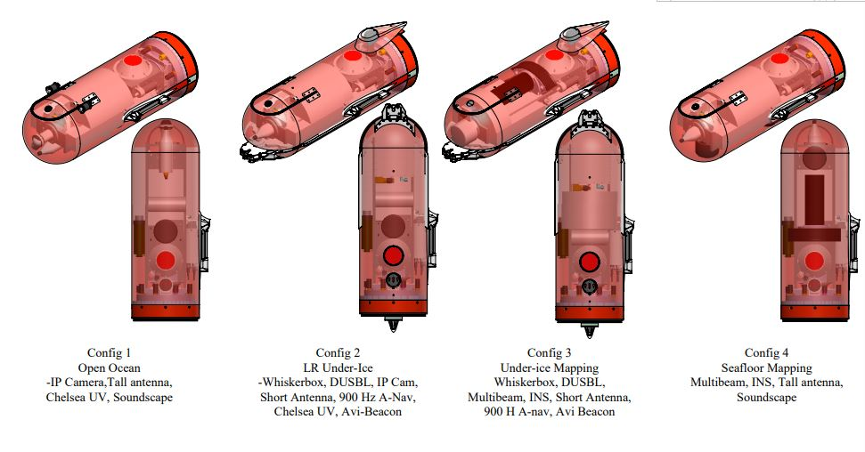
ADAC Program Year 7 Annual Meeting 2-3 June 2021
Where we are going:
  Two LRAUV vehicles with four nose configurations:
    Open water science standard sensors, tall antenna, Chelsea UV, Soundscape
    LR under-ice with Whiskerbox, DUSBL, short antenna, Chelsea UV, Avi-beacon with room for camera, 900 Hz A-Nav
    Under-ice mapping, Whiskerbox, DUSBL, Multibeam, INS, short antenna, 900 Hz A-Nav, Avi Beacon
    Seafloor mapping, Multibeam, INS, tall antenna, soundscape

Slide 11
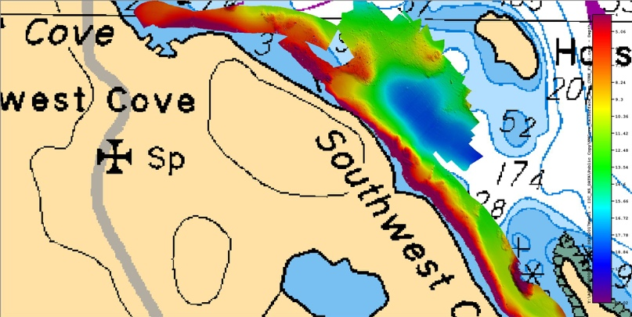
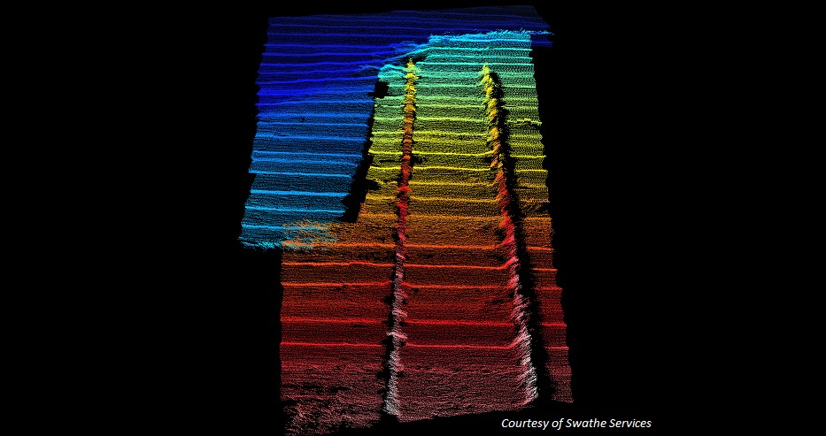
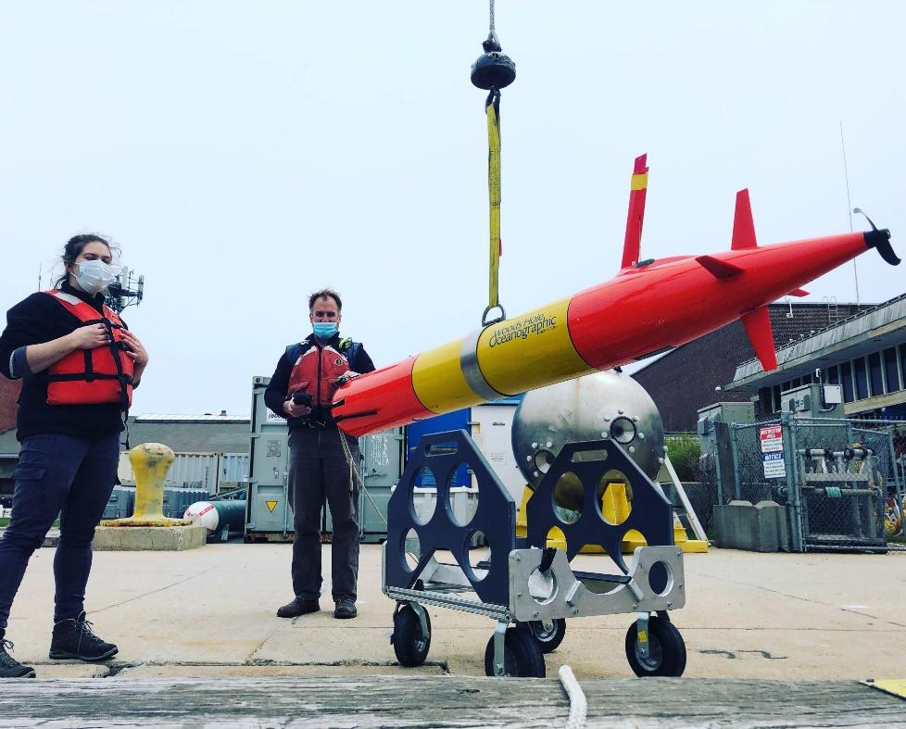
Polaris nose including multibeam
Multi-mission capability
Seafloor mapping
Bathy charts
Shipwreck search/map
Under-ice and glacier mapping
Under-ice and in water oil/gas detection
Notes:
Adding payloads and multi-mission capability
Norbit 400kHz (Frequency Agility 200-700kHz) WBMS Bathymetric System
integrated with Real-time Sonar Head Sound Velocity Sensor. Includes
Snippets, Sidescan, Backscatter and Water Column Output. Includes Sonar
Interface Unit (SIU-I)

Slide 12
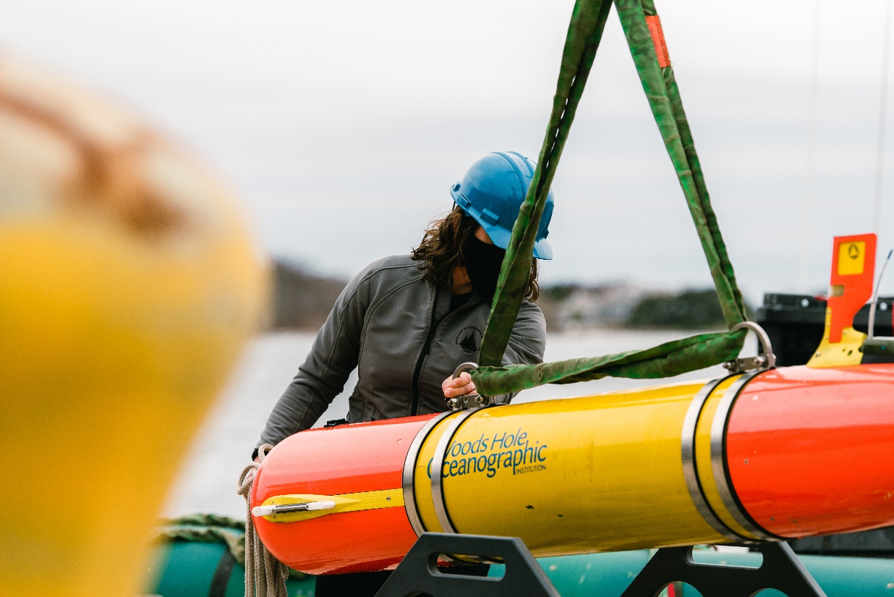
ADAC Program Year 7 Annual Meeting 2-3 June 2021
Where we are going: Growing Applications!
  Fly away capability with rapid response for oil spills, sunken ships (etc.), pipe leaks, seafloor mapping, habitat monitoring, measuring soundscapes (weather, whales, etc.), long-range shipless surveys, open ocean, fresh water and under-ice capabilities over-the-horizon data relay, 24/7 operator response
  Center of Expertise
  Go to for help…it’s already happening…USCG, NTSB, NOAA, USGS, Science community…

Slide 13
Project LRAUV: Schedule and Metrics
ADAC Program Year 7 Annual Meeting 2-3 June 2021
Fabrication of a second platform (Stella)
  Main system parts designed, ordered in YR6
  Main parts received, minus long lead cables still on order and new gear box (arrived!) for the docking nose
  All received parts have been kitted into assemblies and a second stage of checking for missing parts is complete
  Basecamp and a Gannt chart organize and track tasks/progress
  Procure auxiliary equipment
  Transition and training underway
Conduct Arctic Readiness Test, most important and time consuming tasks, majority can be done in Woods Hole (minus high latitude and under-ice)
  Three buoy system completed
  Docking/Undocking reliability ~60% and a new cold weather gear box is being switched out
  Plume tracking algorithm further development in progress (Yanwu @MBARI)
  Comms reliability (antenna/buoy/Dash)
Provide testing documentation and familiarization of LRAUV to USCG
  Includes collaborations with EPA, NOAA, etc. partners
Develop software for improved operator system interface
  Backseat is integrated, now it needs to be developed with an LCM bridge from the front seat.
  Drivers are complete for the multibeam
  Dash operator Portal is complete at LRAUV.WHOI.EDU

Slide 14
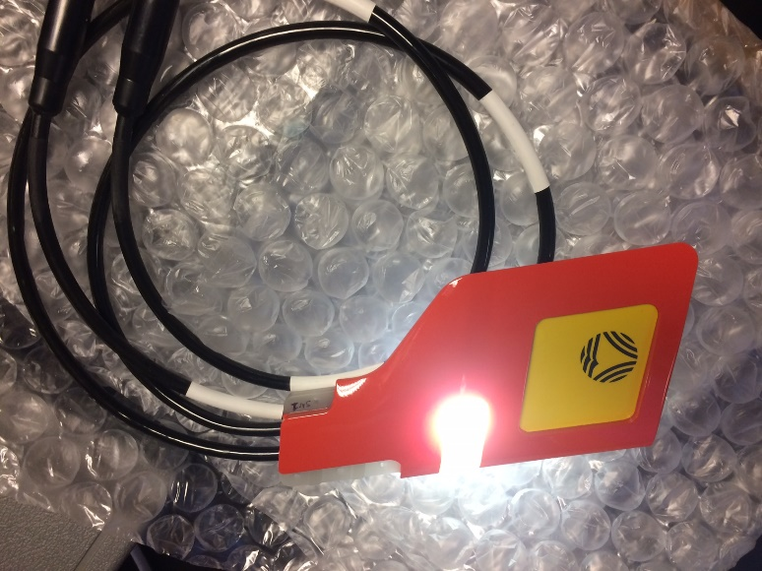
ADAC Program Year 7 Annual Meeting 2-3 June 2021
Redesigned antenna for short and long versions. Completed and water and mission tested!
Developed LARS capabilities
  Designed and implemented a davit on the WHOI R/V Hurricane
  Vehicle can be picked from the nose or with a center bail when installed
  Developed new light weight lifting bails used for helo pick
Designed and procured disposable primary Buoy batteries for 2 week missions
Procured shipping boxes and made custom foam
Build second docking nose
Evaluate alternate power sources (energy harvesting ideas…)

Slide 15
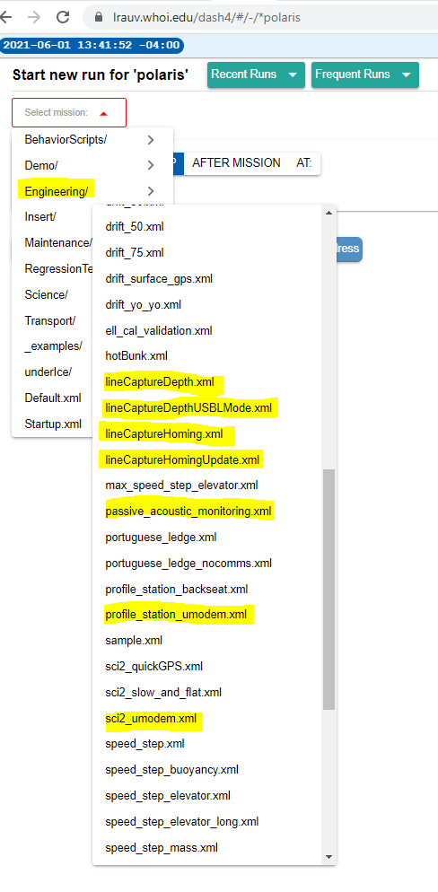
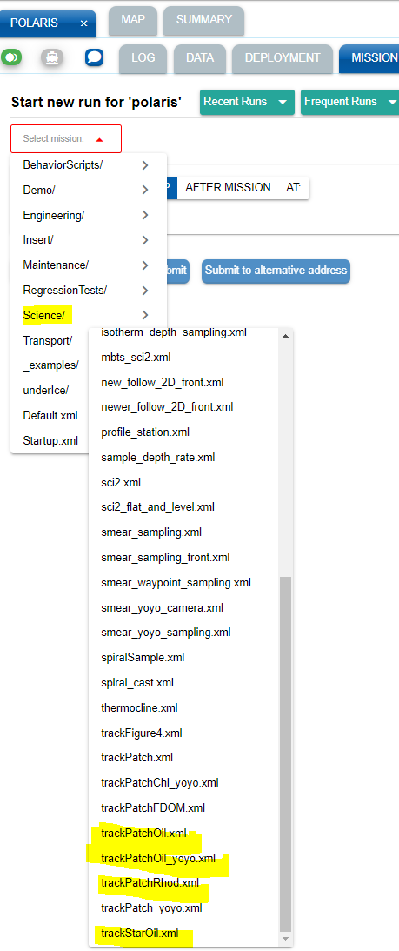
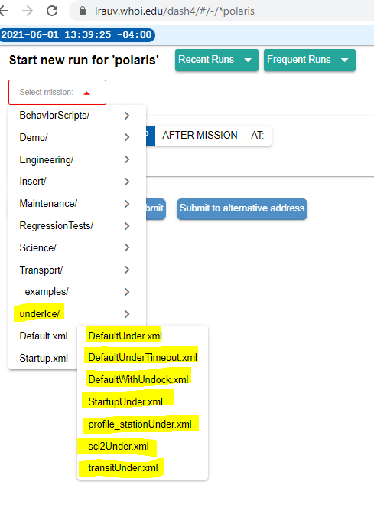
Developed new software behavior missions (>20) for docking, undocking, no surfacing, new sensor configurations, refinement of plume tracking for oil mapping (underway!)

Slide 16
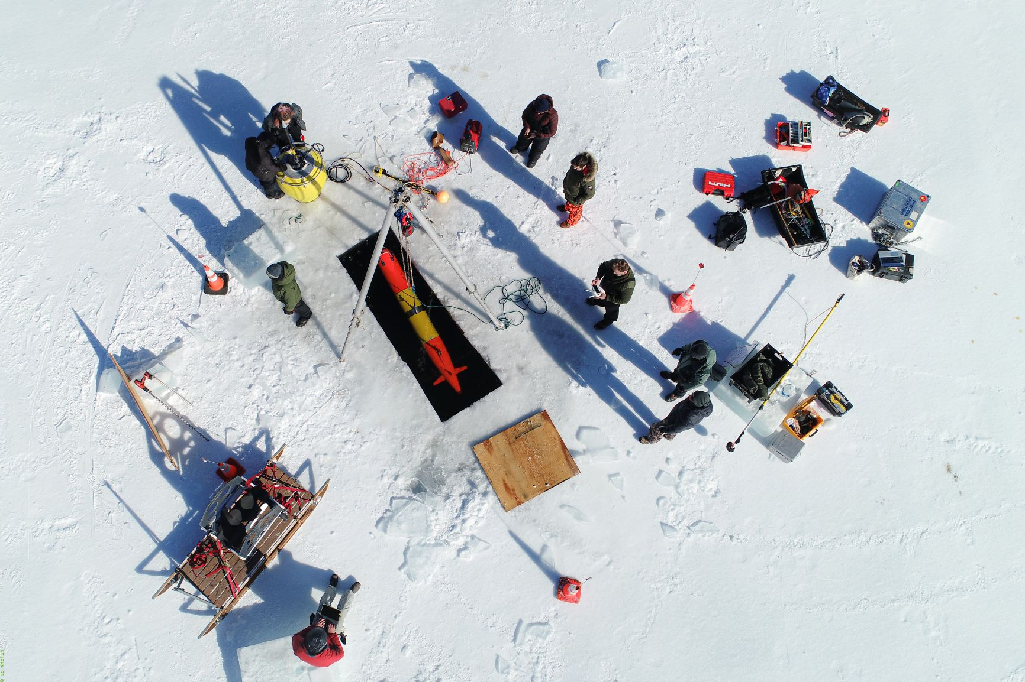
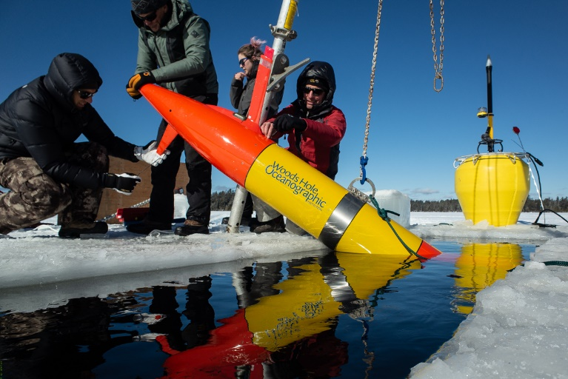
ADAC Program Year 7 Annual Meeting 2-3 June 2021
Conduct New England Ice tests (one test done in YR6, no ice in Woods Hole in YR7)
Conduct GLRS, Lake Superior or equivalent tests- canceled due Covid-19
Find a helicopter deployment opportunity – Completed! 15 April
Build partnership with Woods Hole USCG to be a local operator, user, etc.
Conduct CRREL ice tank tests of sensors- schedule conflict
Prepare for Barrow Summer 2021 Tests- Postponed due to Covid-19 (maybe 2022)

Slide 17
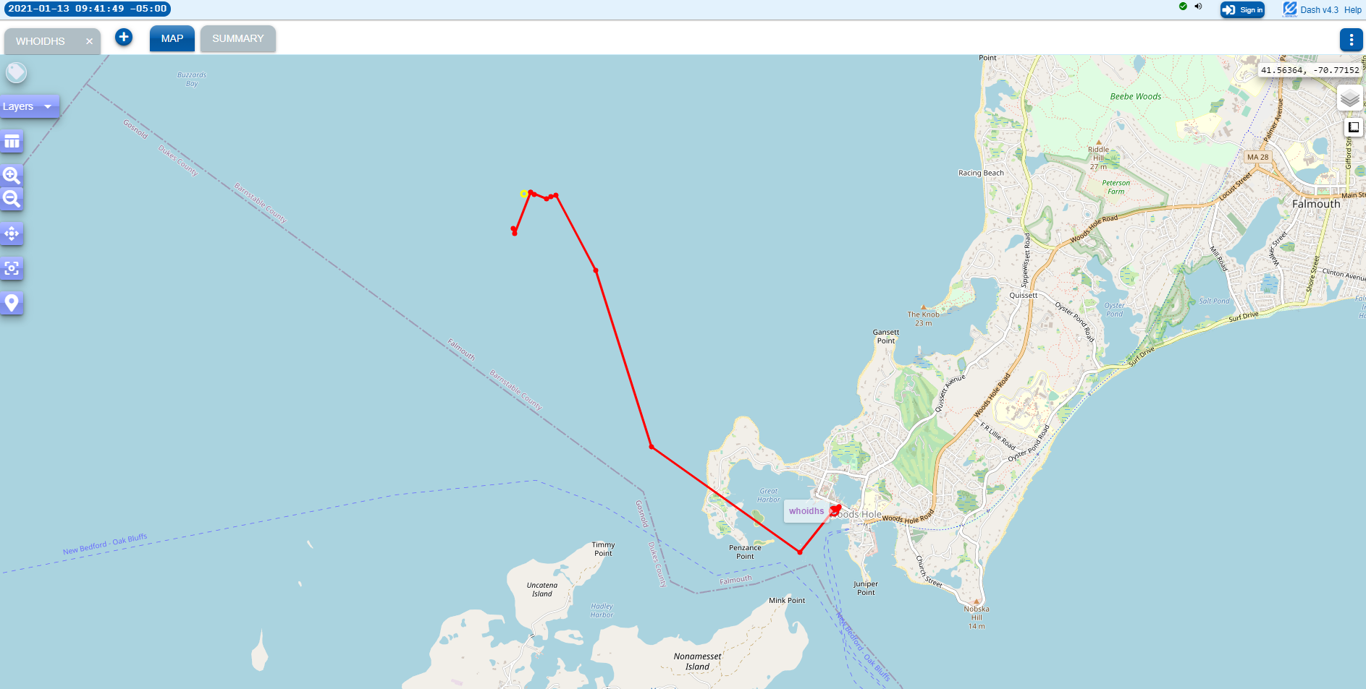
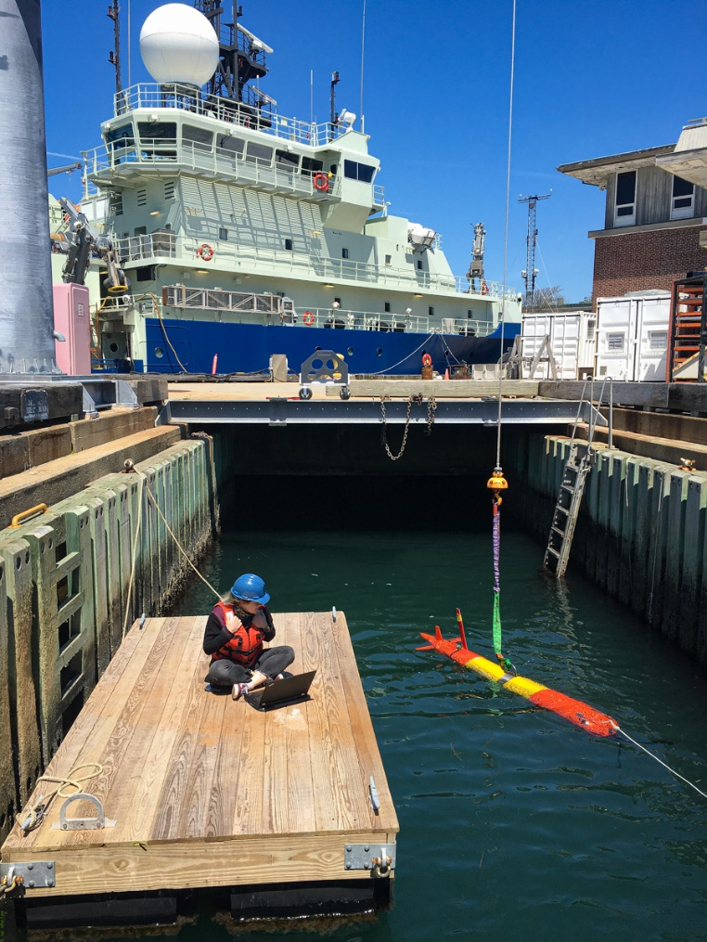
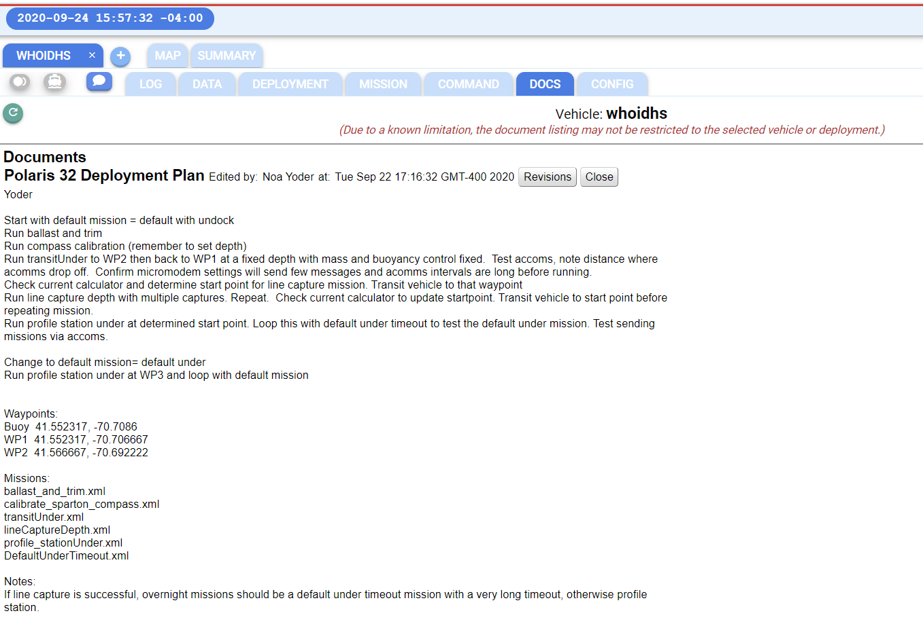
Dash-Command Control:
LRAUV.WHOI.EDU

Slide 18
Project LRAUV: Planned Research Outcomes
ADAC Program Year 7 Annual Meeting 2-3 June 2021
Planned outcomes of the research:
  A helicopter portable Long Range AUV, for under-ice and over-the-horizon shipless anomaly and oil detection with deployable Arctic buoys for aided navigation, remote communication and docking; around-the-clock expertise available and training with a TRL 6/7 system ready for low-rate manufacturing and payload capability expansion.
Additional research identification:
  Service for hire
  Interest in commercialization
  Interest in scientific community to use and develop tech (BSEE, EPA, NOAA, etc.)
    (more vehicles, deeper ratings, recharge capabilities)

Slide 19
Project LRAUV
ADAC Program Year 7 Annual Meeting 2-3 June 2021
  MATTS and STATS for YR7
Talk- (NASA) Destination Space 2021, April 29, 2021, Kukulya
Virtual Training-(USCG), Sector Southeastern New England Waterways, Inspections, response, 11/24/20
In-person collaboration- (USCG), Joint Base Cape Cod (helicopter conops development) and Woods Hole, fall 2020-ongoing
Talk – (NOAA), https://response.restoration.noaa.gov/oil-and-chemical-spills/oil-spills/orr-lecture-series-you-dont-know-what-you-dont-know, What can underwater robots do in a crisis? Everything but the kitchen sink, with Amy Kukulya, Research Engineer, Woods Hole Oceanographic Institution (WHOI), 12/17/20
US Senator Markey’s Office, meeting on USCG and Arctic experts discuss state of security; hope for the future, Kukulya, 12/14/20
Talk, AFE, USFWS Alaska Region, Alaska Marine Science Symposium, “Responding from Afar: New Oil Spill Response Technologies” is scheduled for February 11, 11:00-12:00, Kukulya
UN DESA, Global Policy Dialogue Series, Strengthening Sustainable Forest and Ocean Management to Mitigate Climate Change, 26 May 2021,Panelist, Kukulya,

Slide 20
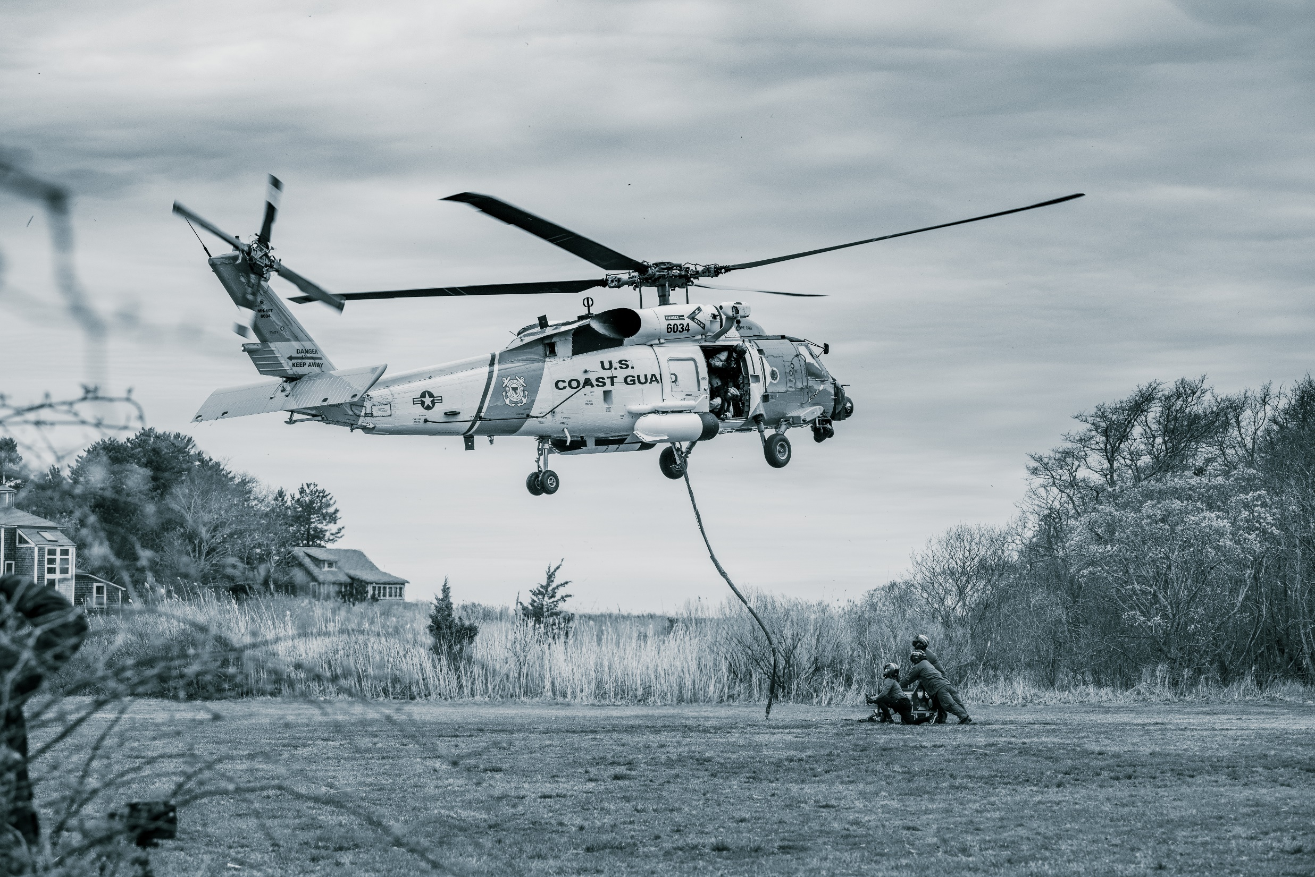
Transition…

Slide 21
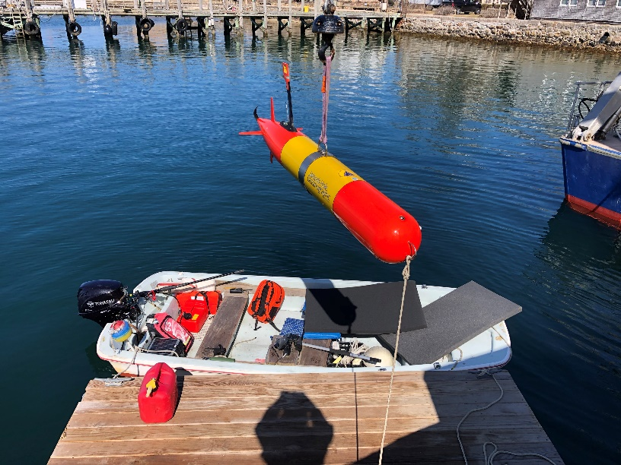
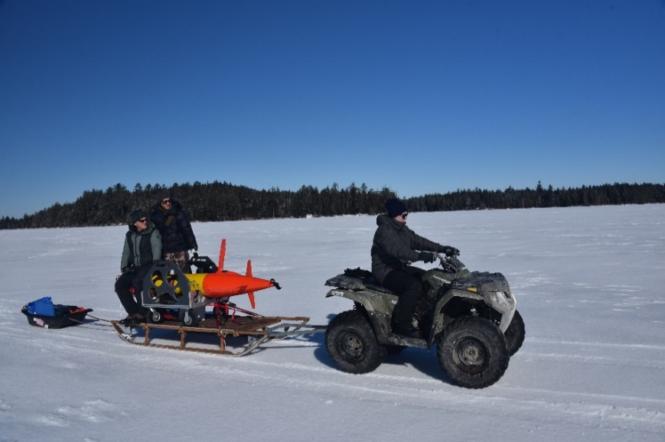
Project LRAUV: Transition Plans
ADAC Program Year 7 Annual Meeting 2-3 June 2021
Two-Stage Transition Plan:
  Build one or more systems to support USCG complete with successful open-water and under-ice demonstrations. WHOI trains USCG operators with support funding. WHOI can support USCG on site or remotely via iridium vehicle communications as needed. 24 hr support possible.
  Commercialize resulting platform: Based on lessons learned from (1), prepare the system for commercialization by accessing WHOI CMR fabrication resources. LRAUV was not designed for efficiency of manufacturing and rapid prototyping, therefore revisiting AUV design is a top priority.

Slide 22
Project LRAUV: Transition Plans
ADAC Program Year 7 Annual Meeting 2-3 June 2021
Pathway to Transition:
Create an operational system that the USCG can use for characterizing spills in ice-covered ocean environments. Transition advantages of the LRAUV platform:
  Contains commercially available sensors
  Can be replicated for the USCG
  Has a proven vehicle design and proven reliability
  Sensor commonality

Slide 23
Project LRAUV: Transition Plans
ADAC Program Year 7 Annual Meeting 2-3 June 2021
Transition Plan includes the following:
  Facilities: WHOI operates facilities for fabrication, testing, logistics (on-ice support) and platforms such as ALVIN
  Service for-Hire: Operators and AUV’s such as the REMUS are available for hire and also have been transitioned into both the Navy and commercial sectors
  Hardware Builds: WHOI has a history of replicating systems and training end users
  Commercialization: Demand for WHOI built systems may occur through spin-off companies or through licensing the technology to a commercial entity. (example: Hydroid Kongsberg with REMUS and Bluefin from MIT, Bellingham)

Slide 24
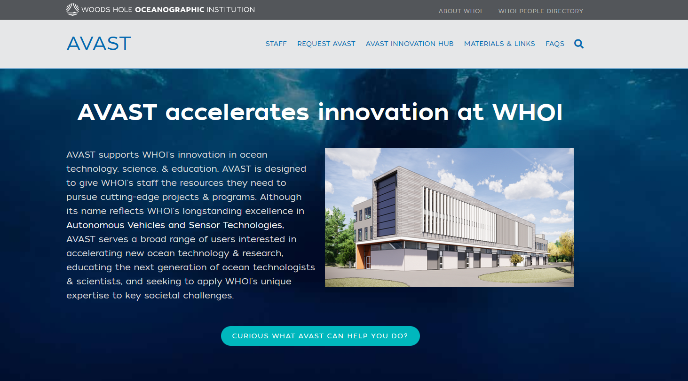
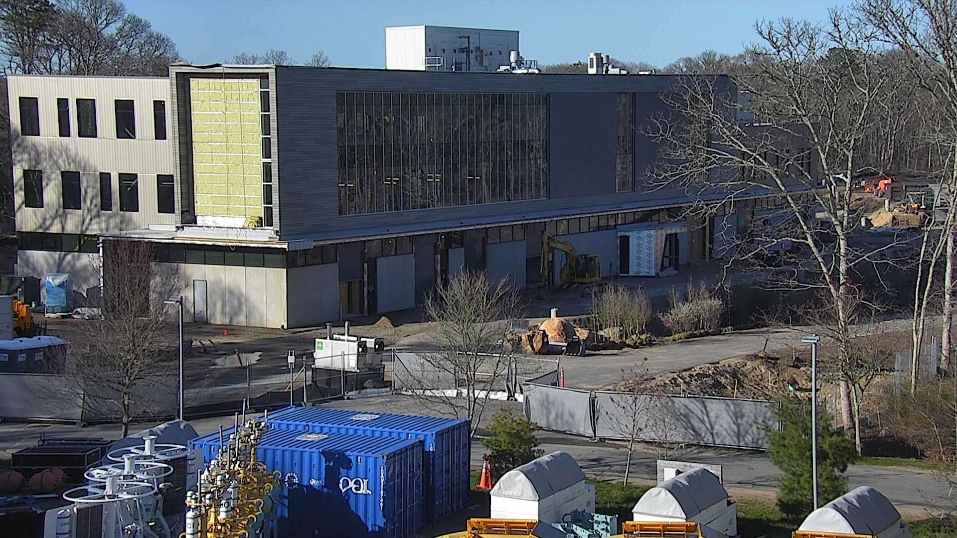
Notes:
Describe how NQF fits in the overall plan, tenants (mooring/rigging, machine shop?, AVAST). Describe the informal advisory groups that operated over the last year, Mark’s establishment of this group.

Slide 25
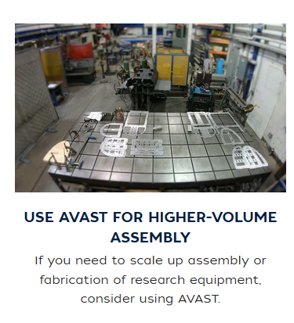
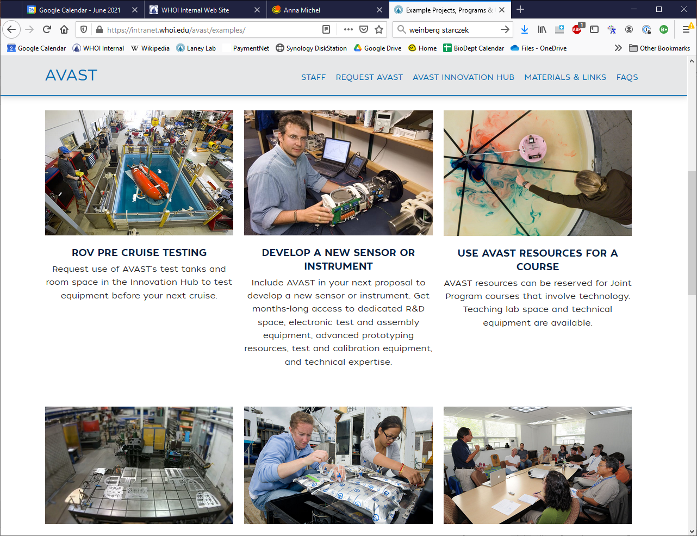
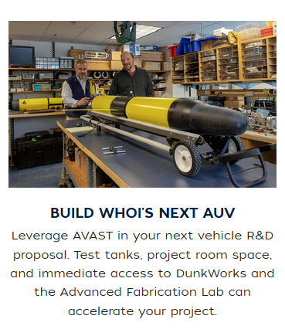
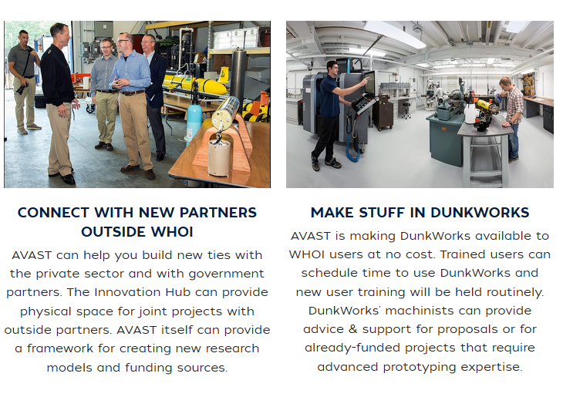
AVAST brings together in one place a wide range of WHOI’s longstanding areas of expertise.

Slide 26


ADAC Program Year 7 Annual Meeting 2-3 June 2021
What needs improvement or is missing?
  Sensing of oil against the ice and seafloor and high latitude testing
  More sensor payloads-Echosounders, Cameras, Water sampling, energy harvesting
  Lower vehicle costs, Design review?
  More operational time for shake-down and training
  Software development (behaviors) and backseat autonomy
Who should we connect with to improve odds of success?
  Engage with USCG operators early and frequently
  Broaden R&D support
  Need to coordinate field operations with first responders and fill technology gaps that are identified.
  Continue to connect with alternative funding sources like ONR, NOAA and BSEE to help fund operations and sensor development (methane, what else?)
  Need more vehicles?
Input on future from you: Do we need 2, 5, 10 vehicles?

Slide 27
Thanks and
LRAUV Ready for questions

Slide 28
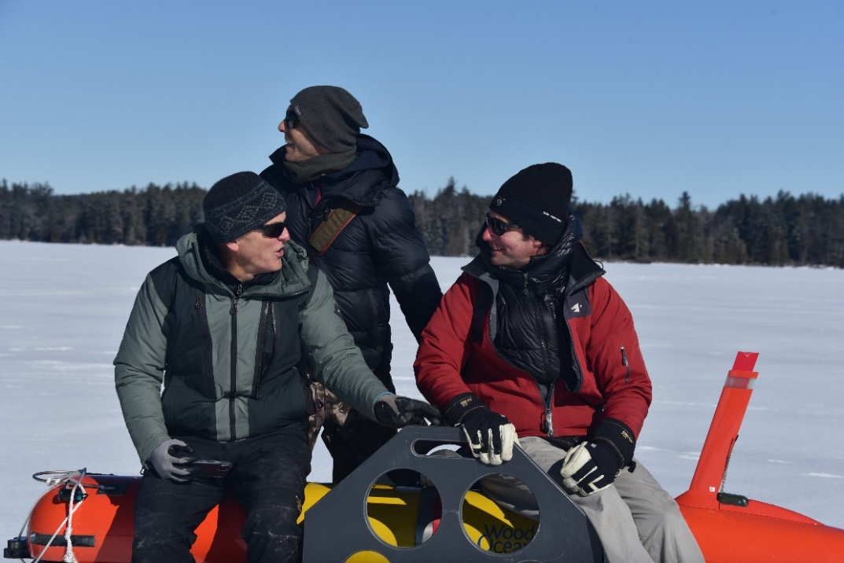
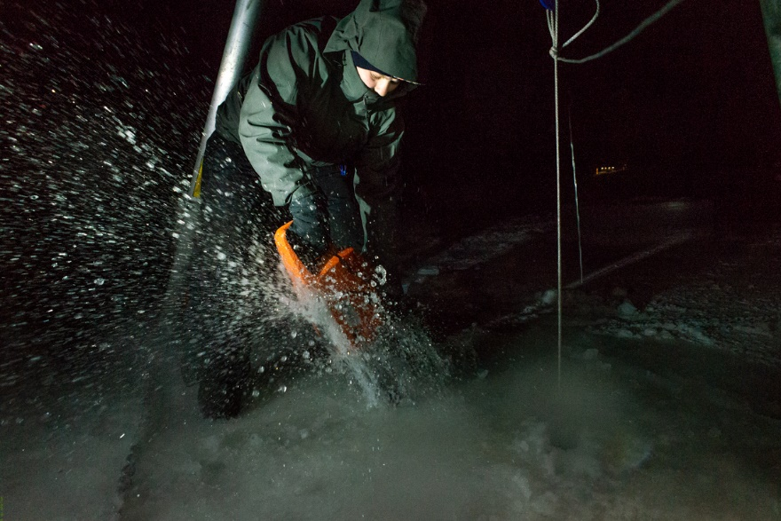
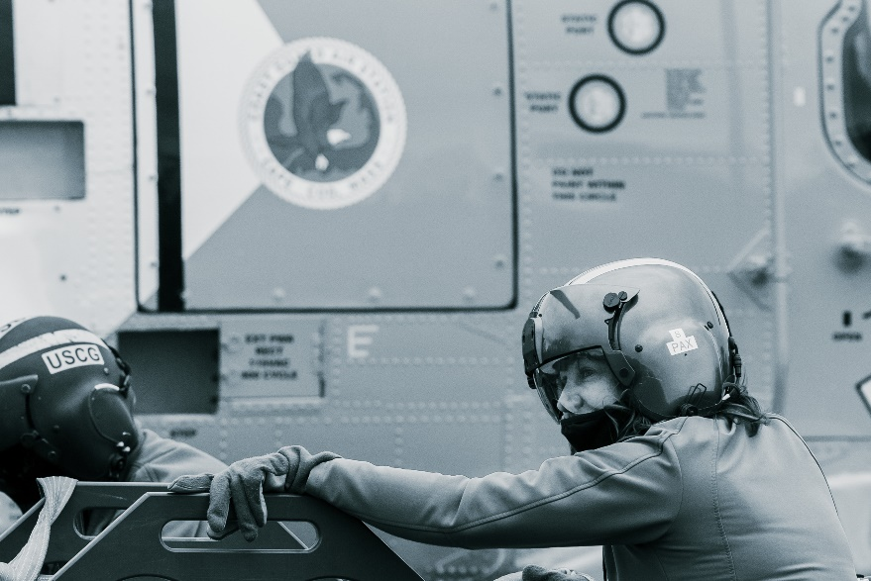
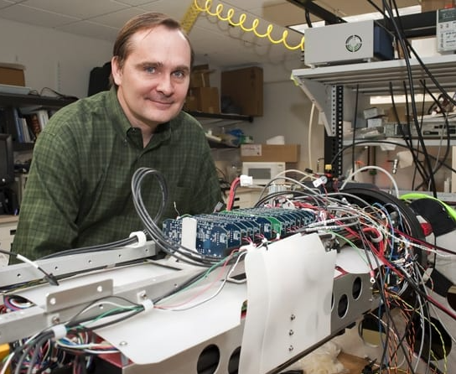
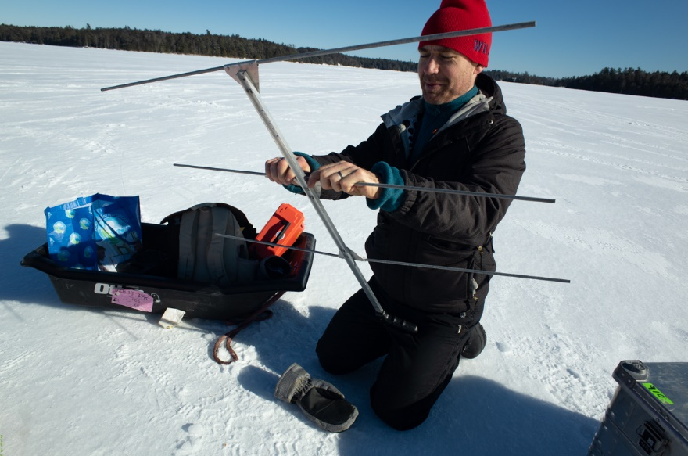
ADAC Program Year 7
The WHOI-MBARI Operations/Engineering Team
Noa Yoder, WHOI
Daniel Gomez-Ibanez
MBARI’s Brett Hobson, Ben Raanan, Brian Kieft
Amy Kukulya
Jim Bellingham
Not pictured: Amanda Besaw, Ryan Govostes, Steven Seeberger

